Slide 1
School of Computing Science and Engineering
Course Code: BCSE2350 Course Name: Cryptographic Fundamental
IP Security

Slide 2
IP Security
have a range of application specific security mechanisms
eg. S/MIME, PGP, Kerberos, SSL/HTTPS
however there are security concerns that cut across protocol layers
would like security implemented by the network for all applications
Notes:
The Internet community has developed application-specific security mechanisms in a number of application areas, including electronic mail (S/MIME, PGP), client/server (Kerberos), Web access (Secure Sockets Layer), and others. However users have some security concerns that cut across protocol layers. By implementing security at the IP level, an organization can ensure secure networking not only for applications that have security mechanisms but also for the many security-ignorant applications.

Slide 3
IPSec
general IP Security mechanisms
provides
authentication
confidentiality
key management
applicable to use over LANs, across public & private WANs, & for the Internet
Notes:
IP-level security encompasses three functional areas: authentication, confidentiality, and key management. The authentication mechanism assures that a received packet was transmitted by the party identified as the source in the packet header, and that the packet has not been altered in transit. The confidentiality facility enables communicating nodes to encrypt messages to prevent eavesdropping by third parties. The key management facility is concerned with the secure exchange of keys. IPSec provides the capability to secure communications across a LAN, across private and public WANs, and across the Internet.

Slide 4
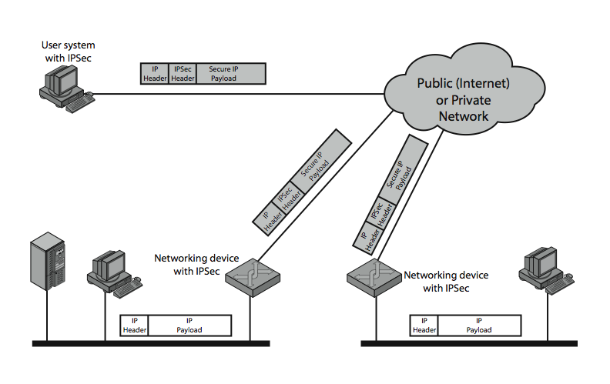
IPSec Uses
Notes:
Stallings Figure 16.1 illustrates a typical IP Security scenario. An organization maintains LANs at dispersed locations. Nonsecure IP traffic is conducted on each LAN. For traffic offsite, through some sort of private or public WAN, IPSec protocols are used. These protocols operate in networking devices, such as a router or firewall, that connect each LAN to the outside world. The IPSec networking device will typically encrypt and compress all traffic going into the WAN, and decrypt and decompress traffic coming from the WAN; these operations are transparent to workstations and servers on the LAN. Secure transmission is also possible with individual users who dial into the WAN. Such user workstations must implement the IPSec protocols to provide security.

Slide 5
Benefits of IPSec
in a firewall/router provides strong security to all traffic crossing the perimeter
in a firewall/router is resistant to bypass
is below transport layer, hence transparent to applications
can be transparent to end users
can provide security for individual users
secures routing architecture
Notes:
[MARK97] lists the benefits shown for IPSec. It also plays a vital role in the routing architecture required for internetworking.

Slide 6
IP Security Architecture
specification is quite complex
defined in numerous RFC’s
incl. RFC 2401/2402/2406/2408
many others, grouped by category
mandatory in IPv6, optional in IPv4
have two security header extensions:
Authentication Header (AH)
Encapsulating Security Payload (ESP)
Notes:
The IPSec specification has become quite complex. The IPSec specification consists of numerous documents. The most important of these,issued in November of 1998, are
• RFC 2401: An overview of a security architecture
• RFC 2402: Description of a packet authentication extension to IPv4 and IPv6
• RFC 2406: Description of a packet encryption extension to IPv4 and IPv6
• RFC 2408: Specification of key management capabilities
In addition to these four RFCs, a number of additional drafts have been published by the IP Security Protocol Working Group set up by the IETF. The documents are divided into seven groups.
Support for these features is mandatory for IPv6 and optional for IPv4.
In both cases, the security features are implemented as extension headers that follow the main IP header. The extension header for authentication is known as the Authentication Header (AH); that for encryption is known as the Encapsulating Security Payload (ESP) header.

Slide 7
IPSec Services
Access control
Connectionless integrity
Data origin authentication
Rejection of replayed packets
a form of partial sequence integrity
Confidentiality (encryption)
Limited traffic flow confidentiality
Notes:
IPSec provides security services at the IP layer by enabling a system to select required security protocols, determine the algorithm(s) to use for the service(s), and put in place any cryptographic keys required to provide the requested services. The security services supported are as shown above. See Stallings Table 16.1 for the services provided by AH & ESP respectively. For ESP, there are two cases: with and without the authentication option. Both AH and ESP are vehicles for access control, based on the distribution of cryptographic keys and the management of traffic flows relative to these security protocols.

Slide 8
Security Associations
a one-way relationship between sender & receiver that affords security for traffic flow
defined by 3 parameters:
Security Parameters Index (SPI)
IP Destination Address
Security Protocol Identifier
has a number of other parameters
seq no, AH & EH info, lifetime etc
have a database of Security Associations
Notes:
A key concept that appears in both the authentication and confidentiality mechanisms for IP is the security association (SA). An association is a one-way relationship between a sender and a receiver that affords security services to the traffic carried on it. If a peer relationship is needed, for two-way secure exchange, then two security associations are required. Security services are afforded to an SA for the use of AH or ESP, but not both.
A security association is uniquely identified by three parameters:
• Security Parameters Index (SPI): A bit string assigned to this SA and having local significance only
• IP Destination Address: this is the address of the destination endpoint of the SA
• Security Protocol Identifier: This indicates whether the association is an AH or ESP security association.
A SA may also have a number of other parameters. In each IPSec implementation, there is a Security Association Database that defines the parameters associated with each SA.

Slide 9
Authentication Header (AH)
provides support for data integrity & authentication of IP packets
end system/router can authenticate user/app
prevents address spoofing attacks by tracking sequence numbers
based on use of a MAC
HMAC-MD5-96 or HMAC-SHA-1-96
parties must share a secret key
Notes:
The Authentication Header provides support for data integrity and authentication of IP packets.The data integrity feature ensures that undetected modification to a packet’s content in transit is not possible. The authentication feature enables an end system or network device to authenticate the user or application and filter traffic accordingly; it also prevents address spoofing attacks and replay attacks. Authentication is based on the use of a message authentication code (MAC), hence the two parties must share a secret key. AH supports MACs using HMAC-MD5-96 or HMAC-SHA-1-96. Both of these use the HMAC algorithm , the first with the MD5 hash code and the second with the SHA-1 hash code. In both cases, the full HMAC value is calculated but then truncated by using the first 96bits, which is the default length for the Authentication Data field.

Slide 10
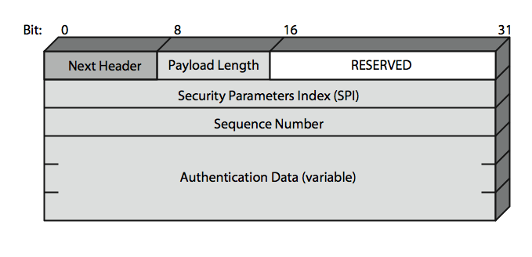
Authentication Header
Notes:
Stallings Figure 16.3 shows the Authentication Header fields:
• Next Header (8 bits): Identifies the type of header immediately following this header
• Payload Length (8 bits): Length of Authentication Header in 32-bit words, minus 2.
• Reserved (16 bits): For future use
• Security Parameters Index (32 bits): Identifies a security association
• Sequence Number (32 bits): A monotonically increasing counter value
• Authentication Data (variable): A variable-length field (must be an integral number of 32-bit words) that contains the Integrity Check Value (ICV), or MAC,for this packet

Slide 11
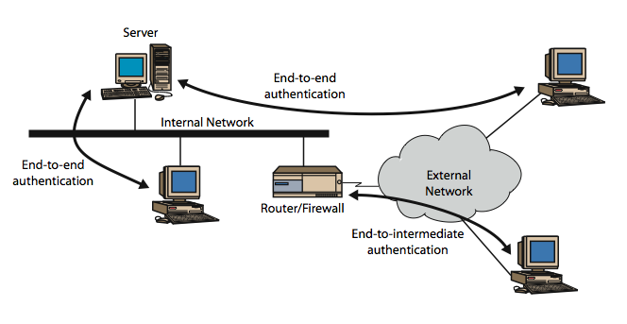
Transport & Tunnel Modes
Notes:
Stallings Figure 16.5 shows the difference between end-to-end (transport) mode and end-to-intermediate (tunnel) mode.
Transport mode provides protection primarily for upper-layer protocol payloads, by inserting the AH after the original IP header and before the IP payload. Typically, transport mode is used for end-to-end communication between two hosts.
Tunnel mode provides protection to the entire IP, after the AH or ESP fields are added to the IP packet, the entire packet plus security fields is treated as the payload of new “outer”IP packet with a new outer IP header. Tunnel mode is used when one or both ends of an SA are a security gateway, such as a firewall or router that implements IPSec.

Slide 12
Encapsulating Security Payload (ESP)
provides message content confidentiality & limited traffic flow confidentiality
can optionally provide the same authentication services as AH
supports range of ciphers, modes, padding
incl. DES, Triple-DES, RC5, IDEA, CAST etc
CBC & other modes
padding needed to fill blocksize, fields, for traffic flow
Notes:
The Encapsulating Security Payload provides confidentiality services, including confidentiality of message contents and limited traffic flow confidentiality. As an optional feature, ESP can also provide an authentication service, with the same MACs as AH. ESP supports range of ciphers, modes, and padding, as shown.

Slide 13
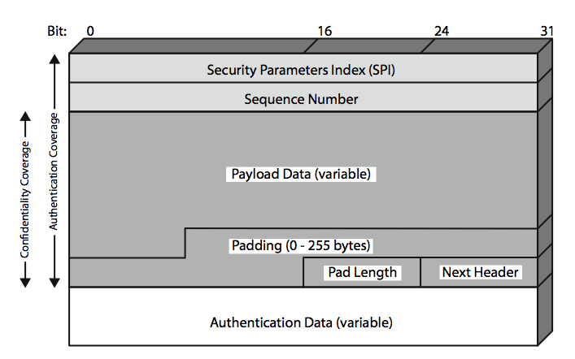
Encapsulating Security Payload
Notes:
Stallings Figure16.7 shows the format of an ESP packet. It contains the following fields:
• Security Parameters Index (32 bits): Identifies a security association
• Sequence Number (32 bits): A monotonically increasing counter value; this provides an anti-replay function ,as discussed for AH
• Payload Data (variable): This is a transport-level segment (transport mode) or IP packet (tunnel mode) that is protected by encryption
• Padding (0–255 bytes): for various reasons
• Pad Length (8 bits): Indicates the number of pad bytes immediately preceding this field
• Next Header (8 bits): Identifies the type of data contained in the payload data field by identifying the first header in that payload
• Authentication Data (variable): A variable-length field that contains the Integrity Check Value computed over the ESP packet minus the Authentication Data field

Slide 14
Transport vs Tunnel Mode ESP
transport mode is used to encrypt & optionally authenticate IP data
data protected but header left in clear
can do traffic analysis but is efficient
good for ESP host to host traffic
tunnel mode encrypts entire IP packet
add new header for next hop
good for VPNs, gateway to gateway security
Notes:
Transport mode ESP is used to encrypt and optionally authenticate the data carried by IP. Transport mode operation provides confidentiality for any application that uses it, thus avoiding the need to implement confidentiality in every individual application. This mode of operation is also reasonably efficient, adding little to the total length of the IP packet. One drawback to this mode is that it is possible to do traffic analysis on the transmitted packets.
Tunnel mode ESP is used to encrypt an entire IP packet. Tunnel mode is useful in a configuration that includes a firewall or other sort of security gateway that protects a trusted network from external networks.

Slide 15
Combining Security Associations
SA’s can implement either AH or ESP
to implement both need to combine SA’s
form a security association bundle
may terminate at different or same endpoints
combined by
transport adjacency
iterated tunneling
issue of authentication & encryption order
Notes:
An individual SA can implement either the AH or ESP protocol but not both. Sometimes a particular traffic flow will call for the services provided by both AH and ESP. Further, a particular traffic flow may require IPSec services between hosts and ,for that same flow, separate services between security gateways, such as firewalls. In all of these cases, multiple SAs must be employed for the same traffic flow to achieve the desired IPSec services. The term security association bundle refers to a sequence of SAs through which traffic must be processed to provide a desired set of IPSec services. The SAs in a bundle may terminate at different endpoints or at the same endpoints.
Security associations may be combined into bundles in two ways:
• Transport adjacency: more than one security protocol on same IP packet, without invoking tunneling
• Iterated tunneling: application of multiple layers of security protocols effected through IP tunneling
One interesting issue is the order in which authentication and encryption may be applied between a given pair of endpoints.

Slide 16
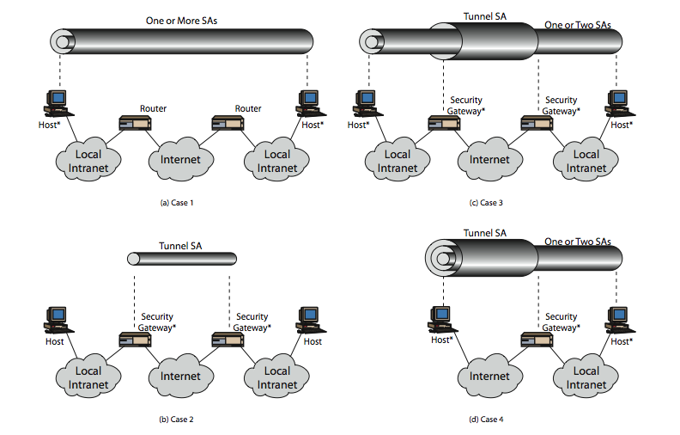
Combining Security Associations
Notes:
The IPSec Architecture document lists four examples of combinations of SAs that must be supported by compliant IPSec hosts or security gateways. These are illustrated in Stallings Figure 16.10. Note the *’d devices implement IPSec. The cases are:
Case 1 security is provided between end systems that implement IPSec.
Case 2 security is provided only between gateways (routers,firewalls,etc.) and no hosts implement IPSec.
Case 3 builds on Case 2 by adding end-to-end security .The same combinations discussed for cases 1 and 2 are allowed here.
Case 4 provides support for a remote host that uses the Internet to reach an organization’s firewall and then to gain access to some server or workstation behind the firewall. Only tunnel mode is required between the remote host and the firewall.

Slide 17
Key Management
handles key generation & distribution
typically need 2 pairs of keys
2 per direction for AH & ESP
manual key management
sysadmin manually configures every system
automated key management
automated system for on demand creation of keys for SA’s in large systems
has Oakley & ISAKMP elements
Notes:
The key management portion of IPSec involves the determination and distribution of secret keys. A typical requirement is four keys for communication between two applications: transmit and receive pairs for both AH and ESP. The IPSec Architecture document mandates support for two types of key management:
• Manual where a system administrator manually configures each system with its own keys and with the keys of other communicating
• Automated where an automated system enables the on-demand creation of keys for SAs and facilitates the use of keys in a large distributed system with an evolving configuration
The default automated key management protocol for IPSec is referred to as ISAKMP/Oakley.

Slide 18
Oakley
a key exchange protocol
based on Diffie-Hellman key exchange
adds features to address weaknesses
cookies, groups (global params), nonces, DH key exchange with authentication
can use arithmetic in prime fields or elliptic curve fields
Notes:
Oakley is a key exchange protocol based on the Diffie-Hellman algorithm but providing added security. Oakley is generic in that it does not dictate specific formats.
Oakley is designed to retain the advantages of Diffie-Hellman while countering its weaknesses.
The Oakley algorithm is characterized by five important features:
It employs a mechanism known as cookies to thwart clogging attacks
2. It enables the two parties to negotiate a group; this, in essence, specifies the global parameters of the Diffie-Hellman key exchange
3. It uses nonces to ensure against replay attacks
4. It enables the exchange of Diffie-Hellman public key values
5. It authenticates the Diffie-Hellman exchange to thwart man-in-the-middle attacks
Oakley supports the use of different groups for the Diffie-Hellman key exchange, being 768, 1024 or 1536 bit primes, or 155 or 185 bit elliptic curves.

Slide 19
ISAKMP
Internet Security Association and Key Management Protocol
provides framework for key management
defines procedures and packet formats to establish, negotiate, modify, & delete SAs
independent of key exchange protocol, encryption alg, & authentication method
Notes:
The Internet Security Association and Key Management Protocol (ISAKMP) provides a framework for Internet key management and provides the specific protocol support, defining procedures and packet formats to establish, negotiate, modify, and delete security associations. ISAKMP defines payloads for exchanging key generation and authentication data. These payload formats provide a consistent framework independent of the specific key exchange protocol, encryption algorithm, and authentication mechanism.

Slide 20
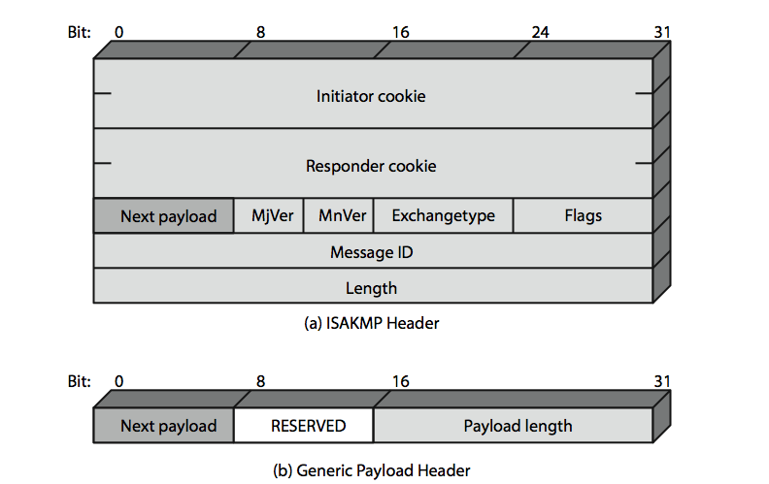
ISAKMP
Notes:
An ISAKMP message consists of an ISAKMP header followed by one or more payloads, carried in a transport protocol (UDP by default).
Stallings Figure16.12a shows the header format for an ISAKMP message. All ISAKMP payloads begin with the same generic payload header shown in Figure 16.12b.

Slide 21
ISAKMP Payloads & Exchanges
have a number of ISAKMP payload types:
Security, Proposal, Transform, Key, Identification, Certificate, Certificate, Hash, Signature, Nonce, Notification, Delete
ISAKMP has framework for 5 types of message exchanges:
base, identity protection, authentication only, aggressive, informational
Notes:
Stallings Table16.3 summarizes the payload types defined for ISAKMP, and lists the fields, or parameters, that are part of each payload. See text for details.
ISAKMP provides a framework for message exchange, with the payload types serving as the building blocks. The specification identifies five default exchange types that should be supported; these are summarized in Stallings Table16.4.

Slide 22
Summary
have considered:
IPSec security framework
AH
ESP
key management & Oakley/ISAKMP
Notes:
Chapter 16 summary.

